Slide 1
MEDTECH PROTOTYPE | APPLIED AI | DATA ENGINEERING
Automated Pill Dispenser
Dispense, verify, and measure every dose: a $100 to $150 station that closes the medication adherence loop
3D-printed carousel + edge computer vision + Databricks analytics
45-minute session, including a 15-minute live demo
github.com/arewa-builds/AutomatedPillDispenser
Notes:
Slide 1. Title (0:00 to 1:00)
Good evening everyone. Thank you for being here.
Today I'm going to provide a demonstration of my most recent project, the Automated Pill Dispenser. It's a small station that does three things for every dose: it dispenses the pill, it uses a camera to confirm the patient is there and that the pill actually dropped, and it streams every event into Databricks. The station costs between 100 and 150 dollars to build.
The idea is simple. Medication adherence is usually a guess. This project turns it into data.
We'll spend about 20 minutes on the build, 15 minutes in a live demo of the Databricks tables and dashboard, and then we'll close with the financial case for healthcare.

Slide 2


ABOUT ME
Arewa Ojelade: AI Robotics Engineer
Related builds
GitHub: github.com/arewa-builds
Patient Readmissions: 30-day readmission risk model with Tableau
PharmaVerse: synthetic pharma line clearance in Isaac Sim
SurgicalVision: CPU-only surgical simulation coaching
Background
AI and Robotics Engineer Pharmaceutical Manufacturing
monitoring, calibration automation, anomaly detection
University of Maryland Global Campus
B.S. Computer Science; MBA, Data Science concentration
Toolkit
Python, FastAPI, LangChain, LangGraph, ONNX Runtime, OpenCV, MediaPipe, Databricks, Arduino, OpenSCAD
Notes:
Slide 2. About me (1:00 to 2:00)
A little bit about me. My name is Arewa. I'm an AI Robotics Engineer in the Pharmaceutical Manufacturing sector, and I have evolved to working at the intersection of artificial intelligence, hardware and data , specializing in manufacturing monitoring, anomaly detection and omniverse simulation research.
I studied computer science for my bachelors and am currently finishing up my MBA with a data science concentration.
My most recent project showcased for South Florida Data Geeks is an Isolation Forest model that predicts 30-day hospital readmission risk visualized with Tableau. I have also recently been conducting research on building virtual omniverse pharmaceutical manufacturing environments to generated labled synthetic computer vision data to evaluate models and test physical AI before deploying in real production line.

Slide 3
AGENDA
Where the next 45 minutes go
0 to 7 min
Intro and problem
Why non-adherence is a clinical problem as much as a data one
7 to 11 min
System design
Four layers, one closed loop from servo to dashboard
11 to 20 min
Build highlights
Mechanism, vision, data pipeline, and safety findings
20 to 35 min
Live demo
Device mock run, Bronze to Gold tables, dashboard walkthrough
35 to 43 min
Financial impact
Non-adherence cost, readmission penalties, savings, dementia care
43 to 45 min
Roadmap and Q&A
What ships next and what still needs validation
Notes:
Slide 3. Agenda (2:00 to 3:00)
Here's where the next 45 minutes go.
We start with the problem, then the system design, then four build highlights for about 20 to 35 minutes, then we dive into the demo and explore our dashboard in Databricks. That's the centerpiece. After that, we discuss the financial impact, and we finish with the roadmap and your questions.
If the live connection misbehaves, I have a backup slide with every number already verified, so we won't lose anything.

Slide 4
THE PROBLEM
Half of filled prescriptions are taken incorrectly, and the cost lands on hospitals
$100-300B
~50%
125,000
10%
Direct US health care cost tied to non-adherence every year
Of filled prescriptions taken incorrectly: timing, dose, frequency, or duration
US deaths per year attributed to poor medication adherence
Of US hospitalizations linked to non-adherence
Timing is the most common failure mode, and it is exactly what a connected dispenser can observe and timestamp.
Source: CDC MMWR 2017, NIH PMC review 2023
Notes:
Slide 4. The problem (3:00 to 5:00)
Let’s talk about the problem this project aims to solve
According to the CDC, about half of filled prescriptions are taken incorrectly. Incorrectly can be defined as wrong timing, the wrong dose, the wrong frequency, or stopping too early.
Non-adherence costs the US health system between 100 and 300 billion dollars a year in direct costs. It's linked to about 125,000 deaths a year and to roughly 10 percent of hospitalizations.
[Pause.]
The point I want you to remember as engineers is this: the most common failure is timing, and timing is almost never recorded.
That missing data is the opportunity, and a connected dispenser can observe and timestamp it.

Slide 5
THE GAP
Reminders tell patients when; nothing confirms that it happened
Typical pillbox or reminder app
This prototype
Alarm fires at dose time
No proof the right person was there
No proof a single pill came out
Caregiver learns about a miss days later, if at all
Face gate: dispense only when a person is present
Pill check: camera counts what landed in the tray
Every dose logged with drift, latency, and confidence
Trend analytics flag drift before a full miss
Notes:
So what's out there today?
On the left is the typical pillbox or reminder app. An alarm goes off. But there's no proof the right person was there, no proof that exactly one pill came out, and the caregivers usually finds out about a missed dose days later, if at all.
On the right is what this prototype does. First, a face gate: it only dispenses when a person is actually present. Second, a pill check: the camera counts what landed in the tray. Third, every dose is logged with timing drift, latency, and detection confidence. And fourth, the analytics look for drift before it turns into a full missed dose.
That last point matters. People rarely go from perfect to missing doses overnight. They drift later and later first. Drift is an early warning signal.
The design goal is non-invasive caregiving: no wearables, and no app the patient has to open. The device acts, observes, and reports.

Slide 6

SYSTEM DESIGN
Assisted Design - Four Layers
software-first so every layer can be tested without hardware
Layer | Stack | Responsibility
Embedded | Arduino Nano 33 BLE, positional MG90S servo, LiPo + TP4056 + boost | Carousel indexing and dispensing
Edge vision | Python, OpenCV, MediaPipe BlazeFace, PySerial | Face gate, pill count, serial DISPENSE handshake
Data | Databricks Delta tables via SQL Statement Execution API | Bronze, Silver, Gold medallion transforms
Analytics | Databricks AI/BI dashboard on a serverless SQL warehouse | Adherence, drift, status, and dashboard analysis
Hardware budget: $100 to $150 all-in with cloud trial. Mock mode runs everything on a laptop.
Source: AutomatedPillDispenser repo
Notes:
Slide 6. System design (7:00 to 9:00)
The system has four layers.
The embedded layer is an Arduino Nano 33 BLE driving a single positional MG90S servo. It moves the carousel 45 degrees per dose, with absolute stops.
The edge vision layer is Python with OpenCV and MediaPipe, and PySerial
These four run the edge program on the laptop. A dose proceeds only after a face stays in view, the Nano moves the carousel, and the tray shows one new pill.
Python is the program that runs that cycle. It opens the camera, decides when to dispense, writes the JSONL event, and inserts the same row into Bronze when the Databricks token is set.
MediaPipe BlazeFace decides whether a person is in front of the camera. It checks presence, not identity. The carousel does not move until the face stays above the confidence threshold for several frames.
PySerial is the USB link to the Nano on COM3. After the face is stable, Python sends DISPENSE and reads the acknowledgement. That command is what turns the servo.
OpenCV runs the camera and checks the tray. It grabs the laptop camera at index 0, counts pill-colored blobs before and after the move, and draws the preview window. A successful cycle is a count that goes up by one.
The data layer is Databricks Delta tables, written through the SQL Statement Execution API.
The analytics layer is a Databricks dashboard running on a serverless SQL warehouse.
The hardware costs around 100 -150 all-in with the cloud trial.
One design choice I want to highlight: I built this software-first. Every layer runs without the others. The firmware has a host test harness. The edge pipeline has a mock Arduino. And the data transforms run locally on synthetic data before they ever touch Databricks. That's how I could build and test the whole pipeline before the hardware was ready.

Slide 7
ONE DOSE, END TO END
Every dispense becomes a row in Databricks within seconds
1
2
3
4
5
6
Face gate
DISPENSE
Carousel
Pill check
Log
Analyze
8 stable frames at ≥0.65 confidence
release command, ACK, retry limit 2
Servo advances one 45° bin
Count delta in tray, 3 s timeout
Local JSONL + Bronze insert
Silver, Gold, dashboard
Bronze row: event_ts, patient_id, face_match_confidence, pills_detected,
dispense_latency_ms, event_status, hardware_source, retry_count
Source: AutomatedPillDispenser repo
Notes:
Slide 7. One dose, end to end (9:00 to 11:00)
Let's follow one dose through the system.
Step one, the face gate. MediaPipe needs eight stable frames at 0.65 confidence or higher before it allows a dispense. That stops a passing shadow from triggering anything.
Step two, the dispense command enables release. The device acknowledges it, and there's a retry limit of two.
Step three, the servo advances the carousel by one 45-degree bin.
Step four, the pill check. The camera counts pills in the tray against a baseline, with a three-second timeout. We count the change, not the total, because pills stay in the tray. The second dose is a count of two, not another one.
Step five, the event is written to a local JSON Lines file and inserted into the Bronze table in Databricks. If the network is down, the dose is still recorded locally.
Step six, Databricks turns it into Silver and Gold tables and the dashboard.
At the bottom of the slide, you can see the eight fields in every Bronze row. Remember these, because you'll see them live in a few minutes.

Slide 8
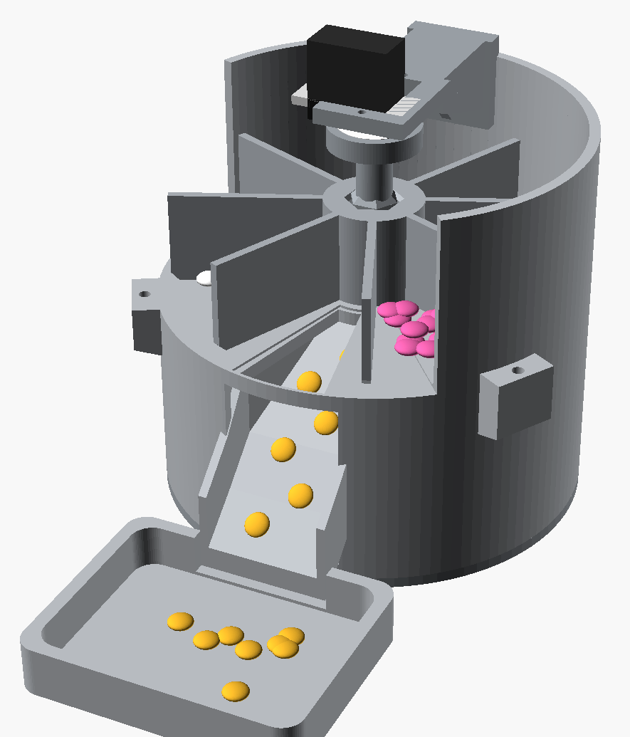
HIGHLIGHT 1: MECHANISM
The v3 design is built around one number: ±6.2° of parking margin
8 bins, 45° steps
Integral deck, open compartments, one positional servo
24° wedge
Single opening over the chute; the emptied bin parks on it
±2.58° play
12 mm hex coupling instead of 7 mm (which would be ±6.28°)
~6x torque
MG90S headroom, so the error budget drives the design
Seven printable parts plus three test coupons; firmware geometry is generated from the CAD so the two cannot drift.
Source: cad/v3 README, firmware README
Notes:
Slide 8. Highlight 1: the mechanism (11:00 to 13:30)
The first highlight is the mechanism. The whole v3 design comes down to one number: plus or minus 6.2 degrees of parking margin.
Here's why. The carousel has eight open bins in 45-degree steps. There's a single 24-degree opening in the deck above the chute. When the carousel is at rest, the bin that was just emptied sits over that opening, so nothing can fall through. Each compartment spans about 36 degrees at that radius, which leaves 6.2 degrees of margin either side. If it parks further off than that, the opening starts draining the next bin. That's why v3 uses a positional servo instead of a continuous-rotation one.
The torque isn't the problem. The MG90S has roughly six times the torque this needs. The problem is the error budget. So I used a 12-millimeter hex coupling instead of 7 millimeters, which cuts the rotational play from about 6.3 degrees down to 2.58.
Assembly tolerances alone can still put the carousel up to 8.6 degrees off center, which is more than the margin. So the firmware has trim and jog commands that shift the stop positions at run time.
My favorite detail: the firmware's geometry constants are generated directly from the CAD parameters file. The mechanical design and the code can't drift apart.

Slide 9
HIGHLIGHT 2: EDGE VISION AND FIRMWARE
Vision decides when to dispense and whether it worked
Face gate
Pill verification
Firmware
MediaPipe Tasks FaceDetector with a vendored BlazeFace short-range model
Reduced-resolution input and a settling phase for fast startup
DirectShow fallback for laptops whose camera will not open
OpenCV HSV threshold plus contour area filter (80 to 8,000 px)
Counts new pills against a baseline, so stacked doses are caught
Status recorded as success, retry, or failure
Non-blocking state machine on one MG90S (pin D9)
REZERO when the magazine is spent, before the turn check
Host test harness runs the sketch logic without hardware
Source: PR #5, PR #9, PR #14, PR #15
Notes:
Slide 9. Highlight 2: edge vision and firmware (13:30 to 16:00)
The second highlight is the vision and firmware layer. Vision decides when to dispense and whether it worked.
For the face gate, I use the MediaPipe Tasks face detector with the BlazeFace short-range model bundled into the repo. It starts up on reduced-resolution frames with a short settling phase, so it's fast.
There's also a DirectShow fallback for Windows laptops where the camera won't open the normal way.
For pill verification, I use an OpenCV color threshold and contour filter, keeping shapes between 80 and 8,000 pixels in area. It counts new pills against the baseline, so if two pills drop at once, it notices. Every event is recorded as success, retry, or failure.
The firmware is a non-blocking state machine on one servo. When the magazine is empty, it re-zeroes before checking the next turn, which prevents the mechanism from burning through cycles.
To be clear about scope: today the camera confirms that a person is present. It doesn't identify who they are. Patient matching is on the roadmap.

Slide 10
HIGHLIGHT 3: DATA PIPELINE
A medallion pipeline turns raw dispense events into an adherence signal
Bronze
bronze_dispense_events
Raw rows inserted per dose by the edge sink
Silver
silver_dispense_events
Adds is_success, scheduled_window, and time_drift_minutes from the 08:00 or 20:00 anchor
Gold
gold_adherence_7d
Adherence rate and risk flag: drift ≥ 15 min or adherence < 85%
Serving
dashboard_daily / weekly / monthly
Calendar spine keeps missed days visible as zero-event rows
Source: PR #20, bronze_dispense_month.sql
Notes:
Slide 10. Highlight 3: the data pipeline (16:00 to 18:00)
The third highlight is the data pipeline, a standard medallion architecture.
Bronze holds the raw rows, inserted once per dose by the edge device. The same schema works for mock runs, synthetic data, and live hardware.
Silver adds three things: whether the dose succeeded, which dose window it belongs to, morning or evening, and the time drift in minutes from the 8 AM or 8 PM schedule.
Gold calculates the adherence rate and a risk flag. The rule is deliberately simple: flag the patient if average drift is 15 minutes or more, or if adherence drops below 85 percent.
The serving tables use a calendar spine, so a day with no doses still shows up as a zero instead of disappearing from the chart.
For the demo, I loaded a 90-day synthetic history from July 1 to September 29: 182 scheduled doses, 172 taken, and 10 missed on August 10 to 14. The missed doses count against adherence in Gold. Later, a machine learning model in MLflow will replace the simple risk rule.

Slide 11
HIGHLIGHT 4: SAFETY FINDINGS
Live bench data caught a multi-pill dispense the moment it happened
What the telemetry showed
Safeguards added in response
5 live bench dispenses on 29 Sep (7:43 to 8:16 PM ET)
One event detected 3 pills; one detected 0 and logged as failure
Four cycles ran within 23 seconds
Result: 178 pills detected across 177 events
Exactly one actuation per dispense cycle
Count-delta verification for the second dose
Wait for the face to leave before the next cycle
REZERO handling to stop magazine burn
Source: Databricks dashboard, AutomatedPillDispenser repo
Notes:
Slide 11. Highlight 4: safety findings (18:00 to 20:00)
The fourth highlight is my favorite, because it's real.
On the evening of September 29, I ran five live dispenses from the actual hardware on my bench, and they went straight into Databricks. I've left them in the dashboard on purpose.
Look at what the telemetry caught. One event detected three pills. One detected zero and was logged as a failure. Four cycles ran within 23 seconds. Across the whole dataset, that's 178 pills detected over 177 events.
That's a multi-pill dispense, which is exactly the kind of safety issue that matters in a medication device. The data caught it the moment it happened.
In response, I added the safeguards on the right: exactly one actuation per dispense cycle, count-change verification for the second dose, waiting for the face to leave before the next cycle, and re-zero handling so the magazine doesn't burn through.
So let's look at this data live.

Slide 12
LIVE DEMO | 15 MINUTES
Demo run of show: from a mock dispense to the adherence dashboard
20:00
2 min
Mock dispense
python pipeline.py --mode mock: face gate, DISPENSE, pill count
22:00
3 min
Bronze
New row lands in bronze_dispense_events via the SQL API
25:00
3 min
Silver and Gold
Drift from the dose anchor; misses counted in adherence
28:00
4 min
Dashboard
90-day trend, the 10 to 14 Aug gap, events by status
32:00
1 min
Two rates
99.44% dispense success vs 94.12% scheduled adherence
33:00
2 min
Risk flag
Why it is on, and what the test events do to drift
Source: Databricks dashboard, AutomatedPillDispenser repo
Notes:
[20:00 to 35:00 | 15 min DEMO]
Pre-flight: set CAMERA_INDEX in edge/config.py to the camera you will use (currently 1); have edge/.env loaded with Databricks credentials; open the SQL editor and the published dashboard in separate tabs.
20:00 Mock dispense (2 min): run python pipeline.py --mode mock from edge/. Point out the face gate status, the DISPENSE handshake, and the pill count overlay.
22:00 Bronze (3 min): SELECT * FROM workspace.pill_dispenser.bronze_dispense_events ORDER BY event_ts DESC LIMIT 5. Show the new row. Explain the local JSONL fallback.
25:00 Silver and Gold (3 min): show silver_dispense_events columns is_success, scheduled_window, time_drift_minutes. Then SELECT * FROM gold_adherence_7d: 187 events, 176 successes, 11 missed, 94.12% adherence, 33.77 min drift, high_adherence_risk = true.
28:00 Dashboard (4 min): Weekly Events Trend plots pills detected per week; note the dip to 4 in the week of 10 Aug (10 missed doses) and the week of 28 Sep showing 10 pills across 9 events. Monthly: July 62, August 52, September 63. Events by status: 167 success, 9 retry, 1 failure.
32:00 Two rates (1 min): dashboard success rate is 176 of 177 = 99.44%, a dispense reliability metric. Scheduled adherence for the synthetic patient is 172 of 182 = 94.51%. Explain why both matter.
33:00 Risk flag (2 min): synthetic doses average 5.94 min of drift; the 5 live test rows are scored against the wrong anchor (223 and 1,183 min), lifting the average to 33.77 and triggering the flag. Turn this into a lesson: data quality and anchor logic matter as much as the model.
If anything fails live, switch to slide 13.

Slide 13
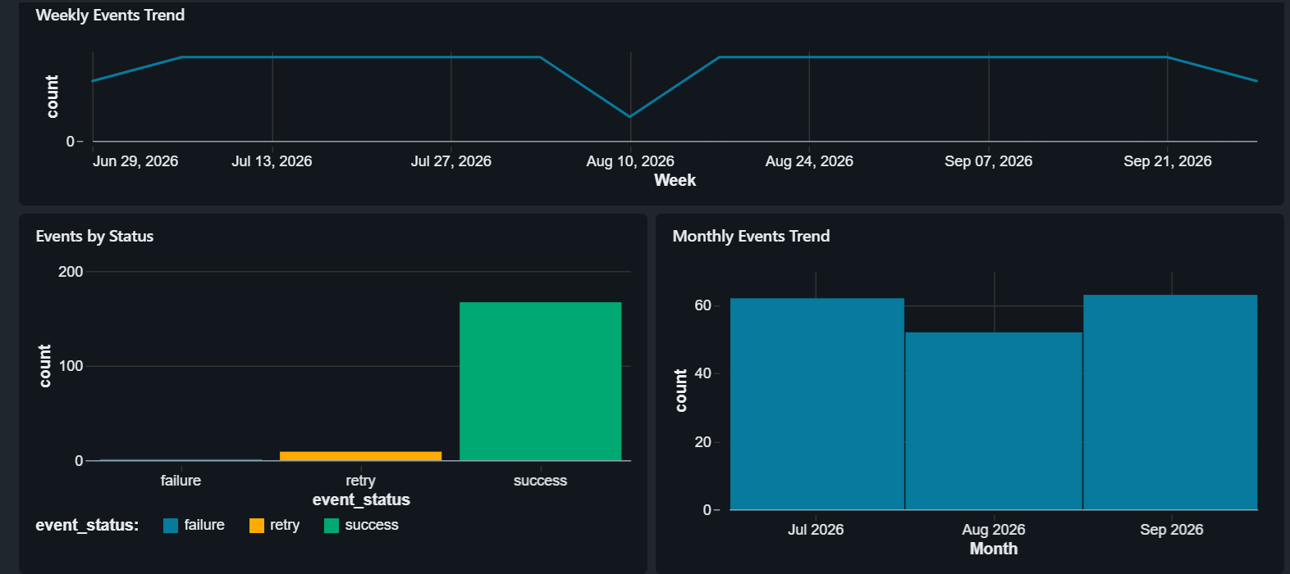
DEMO BACKUP
Verified in Databricks: the dashboard reconciles to the tables row for row
Metric | Dashboard | Synthetic only
Events | 177 | 172
Dispense success | 99.44% | 100%
Pills detected | 178 | 172
Avg time drift | 33.77 min | 5.94 min
Avg latency | 1,246 ms | 1,227 ms
Adherence (Gold) | 94.12% | 94.51%
Synthetic patient: 182 scheduled doses, 1 Jul to 29 Sep 2026, 10 missed (10 to 14 Aug). Plus 5 live bench events on 29 Sep ET.
Source: Databricks dashboard, PR #20
Notes:
Slide 13. Demo backup (only if needed)
[Use only if the live demo fails.]
Here are the same numbers, verified directly against the Databricks tables. The dashboard shows 177 events, 99.44 percent dispense success, 178 pills detected, 33.77 minutes of average drift, 1,246 milliseconds average latency, and 94.12 percent adherence in Gold.
If you take out the five live bench events, the synthetic patient is 172 events, 100 percent dispense success, 5.94 minutes of drift, and 94.51 percent scheduled adherence. The difference between those two columns is the data-quality story I just told.

Slide 14
FINANCIAL IMPACT 1 OF 4
Non-adherence is a $100B to $300B line item that nobody measures at the point of use
3.8 billion
$100B to $300B
Prescriptions written in the US each year
Avoidable direct US health care spending linked to non-adherence each year
1 in 5
New prescriptions never filled
Most of that cost shows up as avoidable hospital admissions, not as pharmacy spend.
$409 billion
2026 US cost of care for people 65+ with dementia
Source: CDC MMWR 2017, Adherence and health care costs, PMC, 2026 Alzheimer's Facts and Figures
Notes:
Slide 14. Financial impact 1 of 4: the national cost (35:00 to 37:00)
Let's talk about Financial Impact
According to the CDC, in the United States, non-adherence is a 100 to 300 billion dollar problem , where dose timing is rarely measured. Most of that cost doesn't show up as pharmacy spending. It shows up as avoidable hospital admissions.
For scale: 3.8 billion prescriptions are written in the US every year, and one in five new prescriptions is never even filled. And for older adults with dementia, care is projected to cost 409 billion dollars in 2026. That's a population where managing medication is especially hard.

Slide 15
FINANCIAL IMPACT 2 OF 4
Readmission penalties make post-discharge adherence a hospital revenue issue
Up to 3%
78.2%
Cut to all Medicare fee-for-service base payments for hospitals with excess readmissions
Of hospitals penalized in FY 2026 (21.8% received no penalty)
240
$16,037
Hospitals (8.1%) facing penalties of 1% or more in FY 2026, up from 208
Mean cost of a single 30-day readmission (all conditions)
Source: CMS HRRP, CMS HRRP impact file guide, Becker's Hospital Review, Readmission cost meta-analysis, PMC 2024
Notes:
Slide 15. Financial impact 2 of 4: readmission penalties (37:00 to 39:00)
For hospitals, this is a revenue issue.
Under Medicare's Hospital Readmissions Reduction Program, a hospital with too many readmissions can lose up to 3 percent of all its Medicare fee-for-service base payments, not just the payments for the readmitted patients.
In fiscal year 2026, about 78 percent of hospitals are being penalized. Only 21.8 percent got no penalty at all. 240 hospitals face penalties of 1 percent or more, up from 208 the year before.
And a single 30-day readmission costs about 16,000 dollars on average.
Here's where the product fits. A dispenser that reports missed or late doses after discharge gives the care team a signal inside that 30-day window, while there's still time to act.

Slide 16
FINANCIAL IMPACT 3 OF 4
Adherent patients save $1,258 to $7,823 a year, against a $150 device
Illustrative unit economics
Device, all-in: $100 to $150
One avoided readmission: $16,037
$16,037 ÷ $108 ≈ 107x the device cost
Benefit-cost ratios from better adherence: 3.1:1 to 10.1:1
Scenario math, not a measured outcome of this prototype.
Source: Roebuck et al., Health Affairs 2011, Readmission cost meta-analysis, PMC 2024, AutomatedPillDispenser repo
Notes:
Slide 16. Financial impact 3 of 4: savings per patient (39:00 to 41:00)
What's the value of better adherence for one patient?
A large Health Affairs study of more than 135,000 patients found that patients who took their medications as prescribed saved money every year, even after paying for the extra medication. The net savings were 7,823 dollars a year for heart failure, 3,908 for hypertension, 3,756 for diabetes, and 1,258 for high cholesterol. The return was between 3 and 10 dollars for every dollar spent.
Now compare that with the device. It costs 100 to 150 dollars. One avoided readmission, at about 16,000 dollars, is roughly 148 times the cost of the device.
To be clear, that's illustrative math, not a measured result. This prototype hasn't been tested with patients yet. But it shows why the unit economics are worth pursuing.

Slide 17
FINANCIAL IMPACT 4 OF 4
For mild dementia, reliable medication routines can mean more years at home
Care setting (2025 US median) | Annual cost
Nursing home, private room | $129,575
Nursing home, semi-private room | $114,975
Assisted living community | $74,400
Prototype dispenser (one-time) | $100 to $150
7.4 million
Americans 65+ living with Alzheimer's dementia in 2026
75%
Of adults 50+ want to stay in their own homes for life
~3 million
Older adults admitted to nursing homes for drug-related problems, over $14B a year
Each year a patient stays home instead of a private nursing home room avoids up to $129,575 in facility cost.
9 of 18
Mild dementia users kept 100% self-administration at 3 months with a reminder device; 11 started at 0%
Source: Alzheimer's Association (CareScout 2025 medians), 2026 Alzheimer's Facts and Figures, AARP 2024, AHRQ, Mild dementia reminder study, PMC 2023
Notes:
Slide 17. Financial impact 4 of 4: dementia and staying at home (41:00 to 43:30)
The last point is the one I care about most: independence.
An estimated 7.4 million Americans aged 65 and older live with Alzheimer's dementia. And 75 percent of adults over 50 say they want to stay in their own homes for life.
Medication is often what breaks that. According to AHRQ, about three million older adults are admitted to nursing homes because of drug-related problems, at a cost of more than 14 billion dollars a year.
Look at the costs on the left. A private nursing home room costs a median of about 129,600 dollars a year. A semi-private room is about 115,000. Assisted living is about 74,400. The dispenser is a one-time cost of around 100 dollars.
There's encouraging evidence too. In a three-month study of 18 people with mild dementia, 11 of them were taking none of their medication independently before using a reminder device. At three months, 9 of the 18 were taking 100 percent of their doses on their own.
That's the human outcome. The patient keeps taking their own medication, and the caregiver gets data instead of daily check-in calls. Every year someone with mild dementia can safely stay at home avoids up to about 129,600 dollars in nursing home costs.
Currently, the prototype hasn't been studied with people who have dementia. This is the target use case, not a proven result.

Slide 18
ROADMAP AND Q&A
What ships next
Safety
Bench-validate one actuation per cycle and face-departure gating on v3
Data quality
Separate bench rows from patient rows; fix anchor drift after midnight UTC
Prediction
MLflow adherence-risk model to replace the drift and rate rule
Identity
Move from face presence to patient match, plus pill color and size checks
Validation
Bench v3 drivetrain, then a supervised pilot with caregivers
Questions? github.com/arewa-builds/AutomatedPillDispenser
Notes:
Slide 18. Roadmap and Q&A (43:30 to 45:00)
So what's next?
On safety, I'll validate one actuation per cycle and face-departure gating on the v3 hardware. On data quality, I'll separate bench test rows from patient rows and fix the drift calculation for doses after midnight UTC. On prediction, an MLflow adherence-risk model will replace the simple rule. On identity, I'll move from detecting that someone is present to matching the right patient, and add pill color and size checks. And for validation, I'll bench-test the v3 drivetrain and then run a supervised pilot with caregivers.
To sum up: the system works end to end, the data has already caught a real safety issue, and the roadmap is specific.
The code is all on GitHub at arewa-builds, under AutomatedPillDispenser. Thank you. I'm happy to take your questions about the data pipeline, the vision thresholds, the mechanism, or the cost model.

Slide 19
APPENDIX
References
Industry and clinical sources
CDC MMWR (2017). Improving Medication Adherence for Chronic Disease Management
NIH PMC review (2023). Integrated drug plans and medication adherence
Iuga & McGuire, PMC (2014). Adherence and health care costs
Roebuck et al., Health Affairs (2011). Adherence lowers health care use and costs
CMS. Hospital Readmissions Reduction Program (HRRP)
CMS. HRRP stratified methodology impact file user guide (3% cap)
Becker's Hospital Review (2025). Higher readmission penalties in FY 2026
PMC (2024). Meta-analysis of 30-day readmission costs
Alzheimer's Association (2026). 2026 Alzheimer's Disease Facts and Figures
Alzheimer's Association. Planning for care costs (CareScout 2025 national medians)
AARP (2024). Home and Community Preferences research insights
AHRQ. Medication management of the community-dwelling older adult
PMC (2023). Medication reminder device for older adults with mild dementia
Project sources
AutomatedPillDispenser GitHub repository
cad/v3 README: v3 mechanism geometry
firmware README: Arduino state machine
PRs #5, #9, #14, #15: vision, REZERO, Databricks sink
PR #20: three-month Bronze history and trend tables
bronze_dispense_month.sql
Pill Dispenser Event Insights, published Databricks dashboard
All Databricks figures were queried from workspace.pill_dispenser on 30 Sep to 1 Oct 2026 (ET).
Notes:
Appendix slide, not part of the timed 45 minutes. Every title is a clickable link to the source.

